Slide 1
Advertising through social media
Student’s Name
Institutional Affiliation

Slide 2
Introduction
This presentation explores the concept of using social media by companies to advertise their products and services.
Today, many companies and businesses are using social media platforms to advertise their products and services.
Social media platforms which are majorly used include Facebook, Twitter, Instagram, and Snapchat.
Advertising through social media is very essential in the 21st century advertisement given the high number of Millenials who are tech-savvy.
It is a must if a company is looking to reach are new targeted audience fast.
This presentation explains how various social media platforms are used in advertising and the rationale for using social media in marketing.

Slide 3
Importance of social media advertising
1. Many customers are on social media
Marketing through social media is one of the most versatile and cost-effective strategies that small businesses can use to reach their target audience and boost sales over time. That’s why 97% of marketers are using social media to reach their audiences.
Many customers are spending a lot of time on social media channels. Statistics show that 70% of the US population has at least one social media profile.
The number of social media users is expected to rise to 3 billion by 2020.
Since many consumers use social media every day, small businesses can reach them by social media.

Slide 4
2. Social media marketing helps increase brand recognition
marketing through social media helps you to improve visibility, thus increasing recognition of your product (Wright et al., 2010).
Through social media, you make your product to millions of potential customers.
By posting compelling and attractive content that adds value to the target audience, you make your product familiar and accessible to the customers.
Many customers may not have heard of a certain product but as they browse through their social media accounts, they are able to learn more about the brand and the value that your company provides.
They may be interested in buying the product and they end up becoming your customers.

Slide 5
3. Different social media platforms enables you to reach the target audiences
Through social media advertisement, you can strategically target different audiences based on the platforms that your brand is active on (Khang et al. 2012).
You can filter and reach your target market instead of just putting your marketing message for everyone to see.
The key to getting out of social media advertisement is to strategically choose which platforms or channels to invest your money, time and effort in.
This helps you dedicate your effort to your potential customers.
Social media also helps you to target and retarget ideal customers.

Slide 6
4. Advertisement through social media is cost effective
Another benefit of social media marketing is that it is cost effective.
Through social media advertisement, you can cut marketing costs without sacrificing results (Wright, 2010).
Depending on your goals and scope of your campaign, it is relatively cheaper to run paid ads on social medial platforms like Twitter and Facebook.
Most of your social media results will come from investing time in creating and publishing content as well as having conversations with your fans and followers.

Slide 7
5. Social media marketing helps you to interact with your customers
Social media advertisement helps interact with your customers through asking and answering questions.
You can use the social media platforms to explain to your customers how a certain product or service works. This can be facilitate by a question and answer session.
clients with various problems can chat with the support team who provide solutions for the queries raised.
For example, when using Facebook, there are videos which familiarize customers with the services provided.

Slide 8
6. Social media marketing helps you gain new customer insights
By chatting with the consumers online, you get an opportunity to know new insights into your customers.
You are able to know what the customers are interested in and what drives them (Khang et al. 2012).
You are able to trace changes in demand by checking on what the customers are talking about on social media. That way, you have a better understanding of what they care about most.
You can ascertain your customer satisfaction, challenges and critics and this helps you improve where necessary.

Slide 9

Example of a Facebook post
The post is an advert of mobile phone by Jumia (an online marketing company)

Slide 10
Types of social media platforms for advertisement
Facebook
Facebook is one of the social media platforms which is used by many companies and businesses to advertise their brands.
Facebook ads are meant to create awareness to increase reach, conversations and considerations (Chu, 2011).
Through Facebook, you can post photos and videos which helps you market your products and services.
With Facebook ads, you can choose the type of people you want to reach and deliver the ads to them via their news feed (Chu, 2011).
Through Facebook you can boost your posts, increase conversions on your website, reach people near your business and get video views.

Slide 11
Instagram ads
Instagram supports the same categories of campaign objectives as Facebook which are awareness, consideration and conversion.
Audience considerations is the most popular with millennials.
Instagram ad types include photos, videos, carousel, and collection.
Photos and videos are the regular Instagram post and they show “sponsored” in the top right of the post.
In an Instagram carousel ad, viewers swipe to scroll through different images.
It is also important to caption the photos in order to clarify to the purpose and type of product.

Slide 12
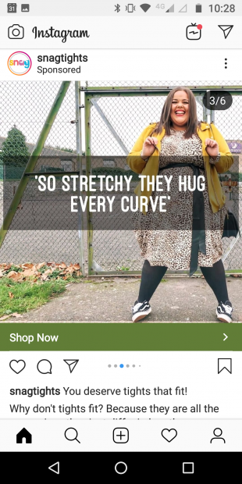
Example of Instagram post

Slide 13
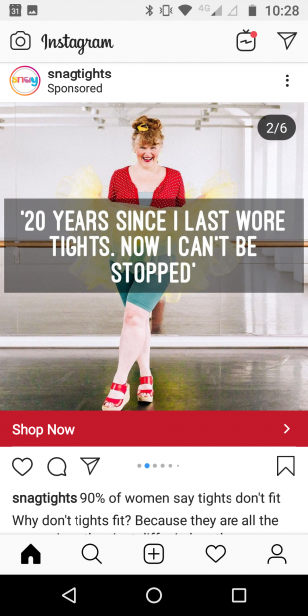
Instagram Post

Slide 14
Twitter Ads
  Twitter ads work towards five different business objectives
  Tweet agreements promote tweet with the goal of starting conversations about your product.
  Followers: promote the Twitter account and pay per follower gained.
  Website clicks: these promote Tweets with website cards to encourage people to visit and act on the website.
  Awareness promote your Tweets to a large audience and pay for impressions (CPM).
  App installs promote tweets with App Cards and pay per click to open your app.

Slide 15
Conclusion
Social media advertisement has become popular and almost inevitable to many businesses which aim at reaching many people globally.
Some of the merits of using social media for marketing include access to many customers online, it is cost effective, increase in brand recognition and it enables you to know the customer insights and demands.
Some of the social media platforms where you can advertise your brand are Twitter, Facebook, and Instagram.
Social media marketing is essential especially with the millennials who are tech-savvy.

Slide 16
References
Chu, S. C. (2011). Viral advertising in social media: Participation in Facebook groups and responses among college-aged users. Journal of interactive advertising, 12(1), 30-43.
Khang, H., Ki, E. J., & Ye, L. (2012). Social media research in advertising, communication, marketing, and public relations, 1997–2010. Journalism & Mass Communication Quarterly, 89(2), 279-298.
Wright, E., Khanfar, N. M., Harrington, C., & Kizer, L. E. (2010). The lasting effects of social media trends on advertising. Journal of Business & Economics Research (JBER), 8(11).

